Slide 1
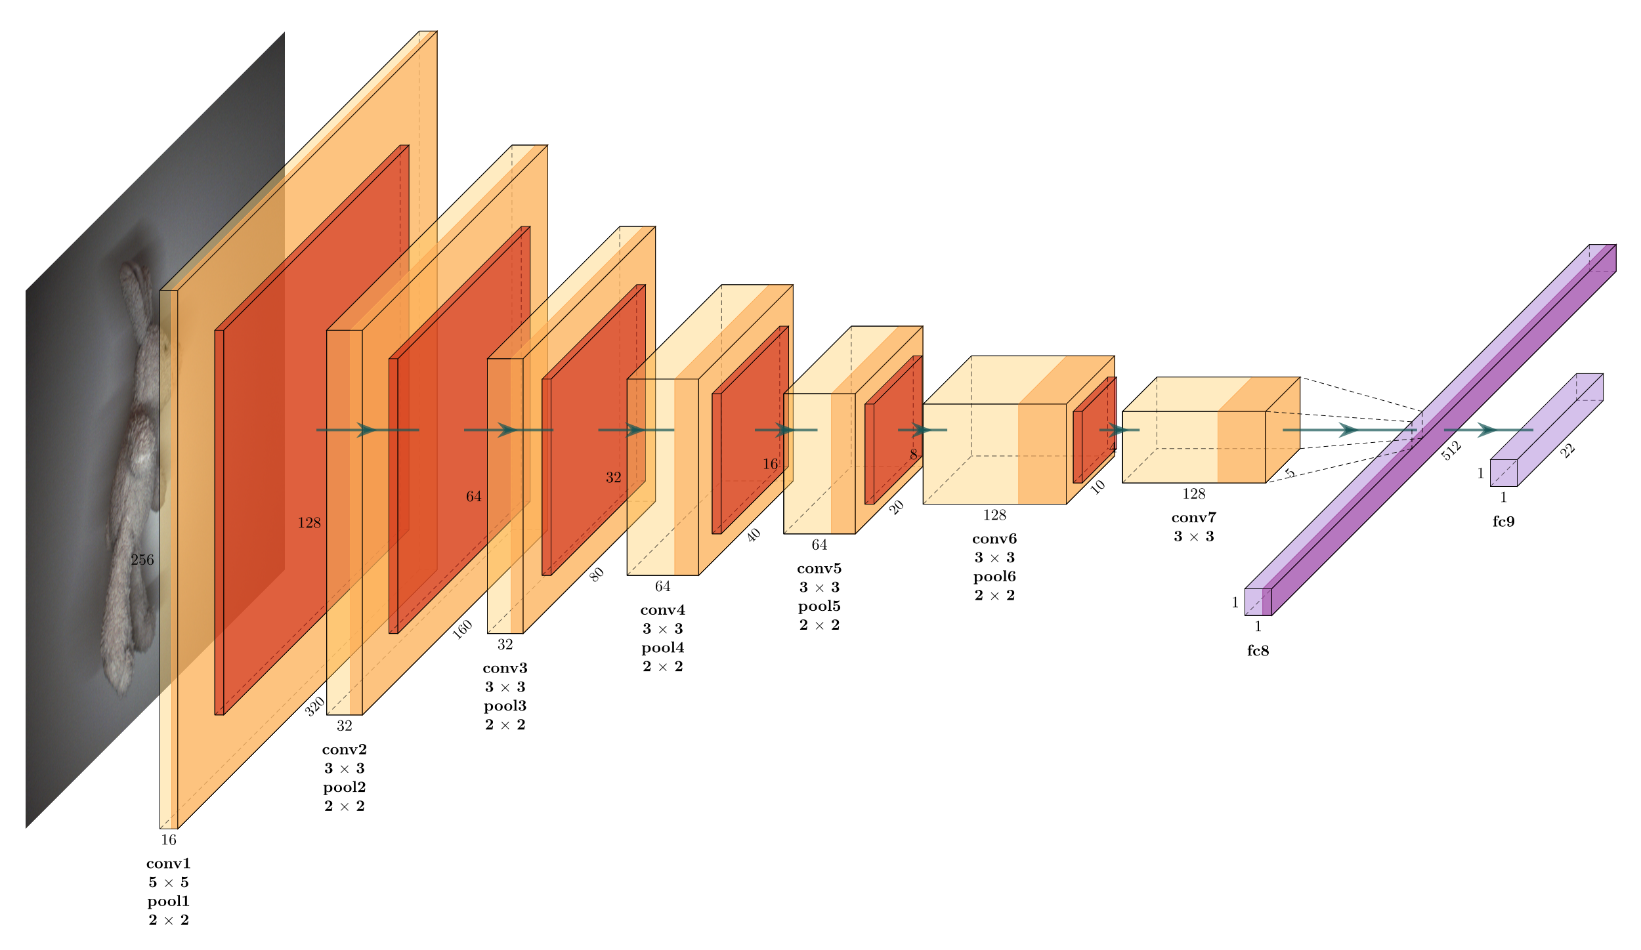
AI High-Performance Solution on FPGA
Bachelor Thesis
by Nico Canzani and Dominik Müller

Slide 2
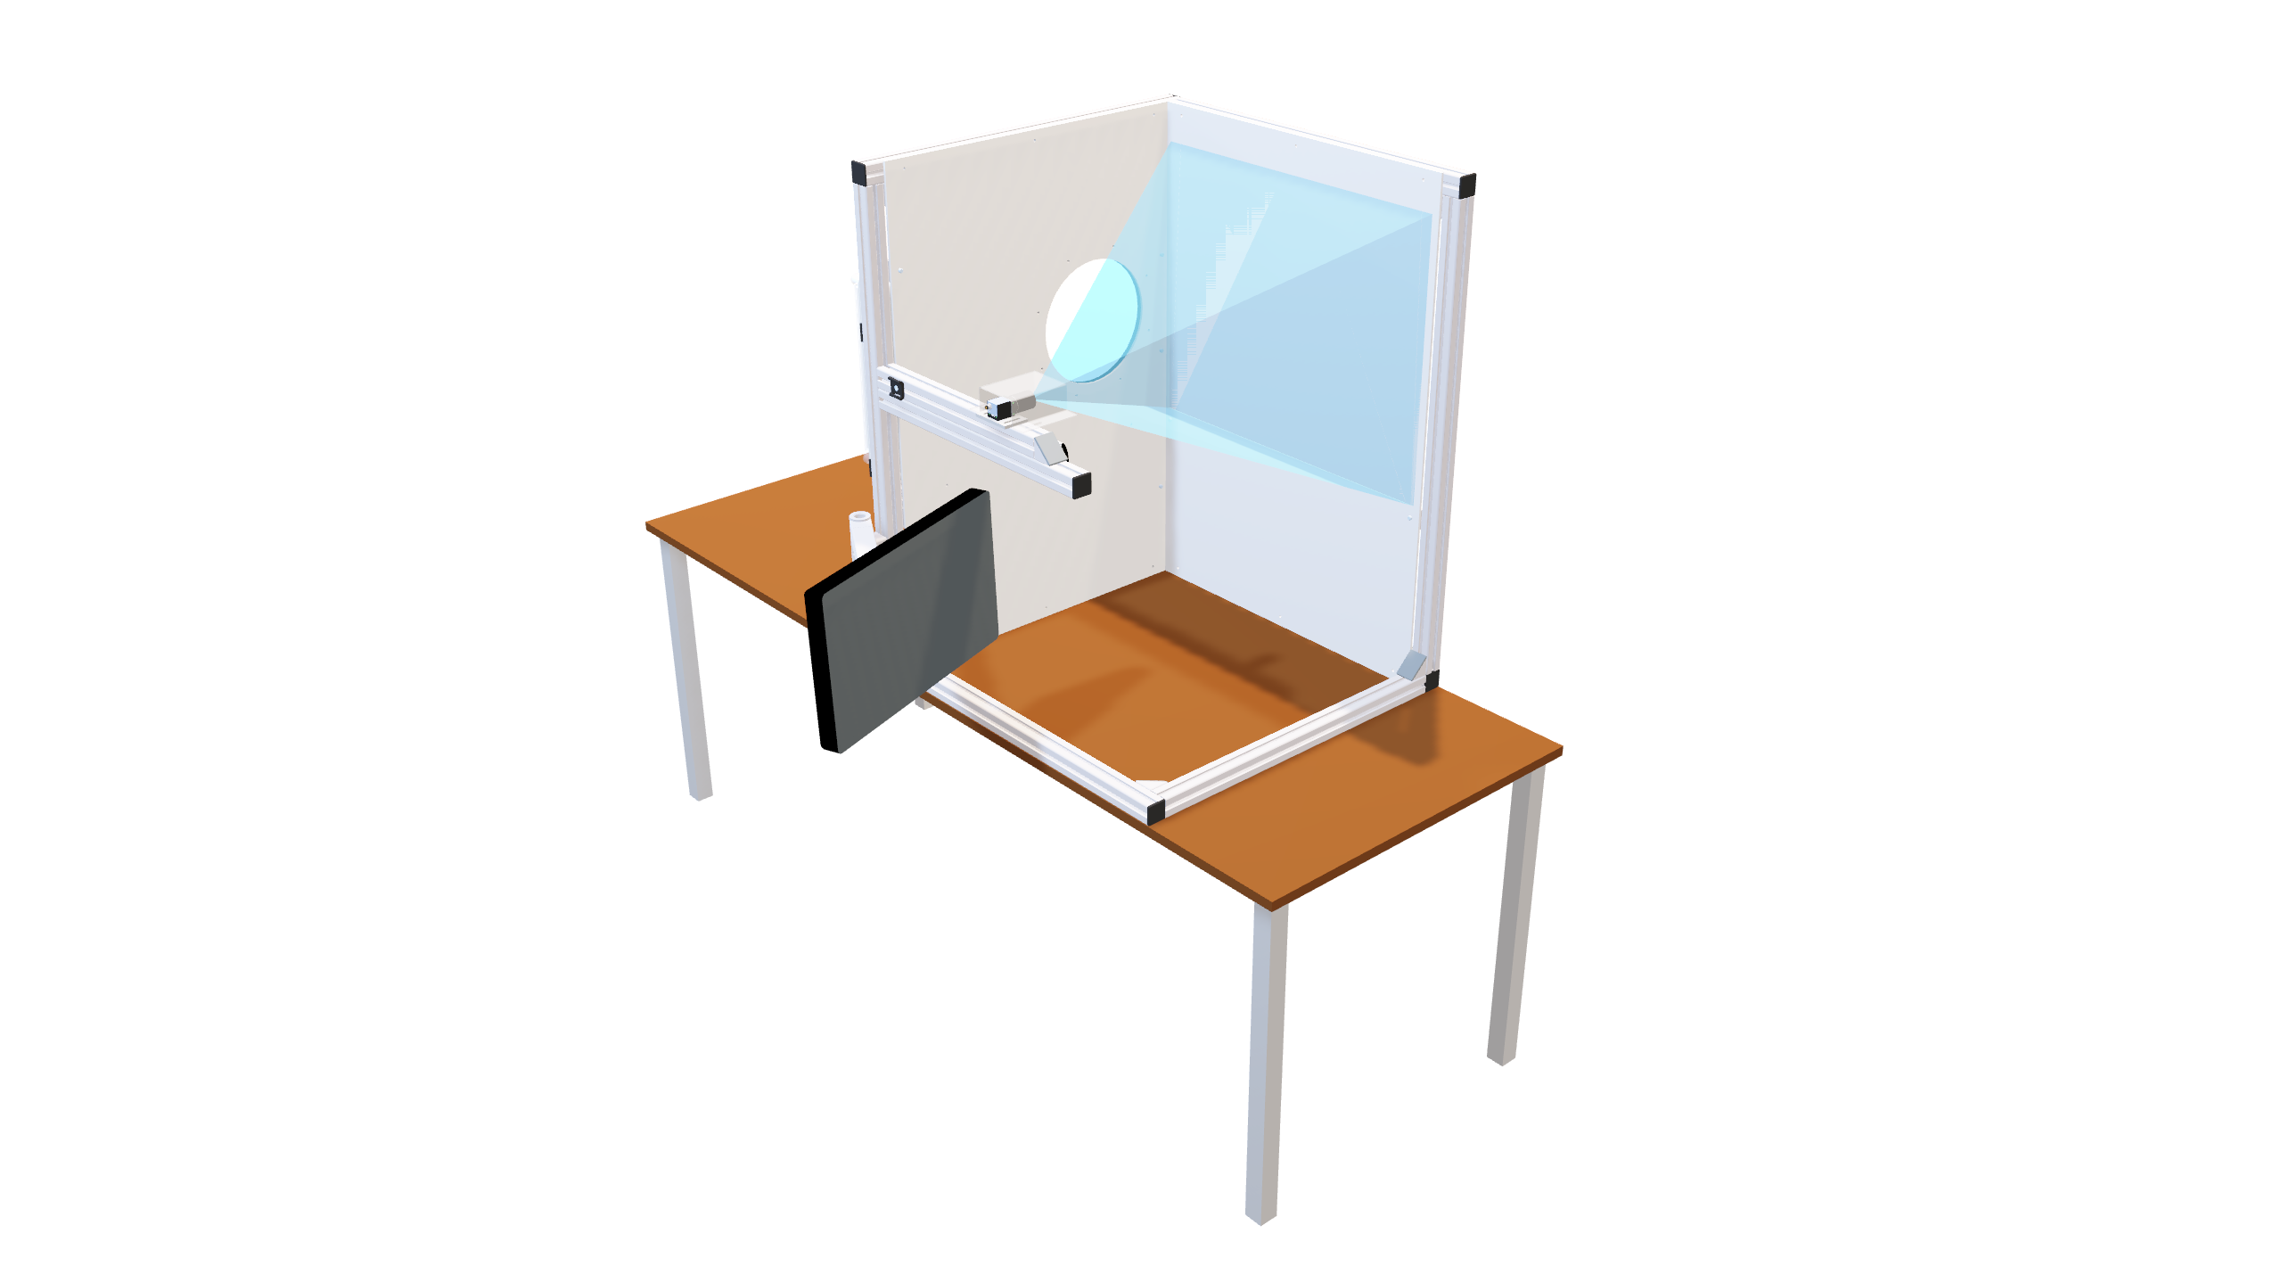

Slide 3
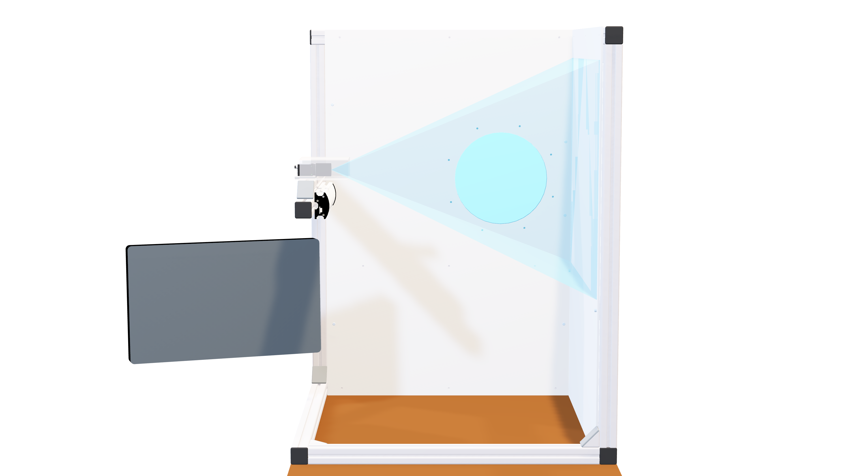
Display

Slide 4
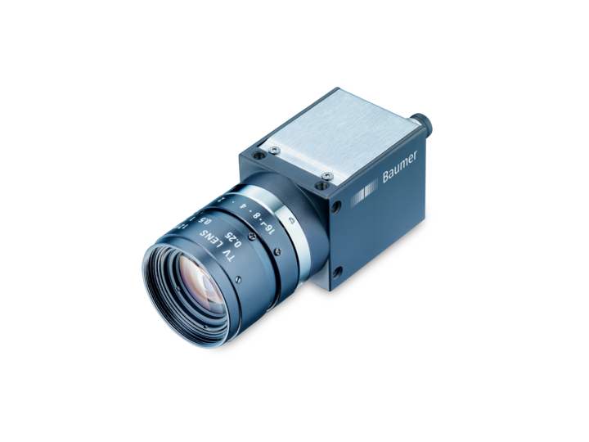
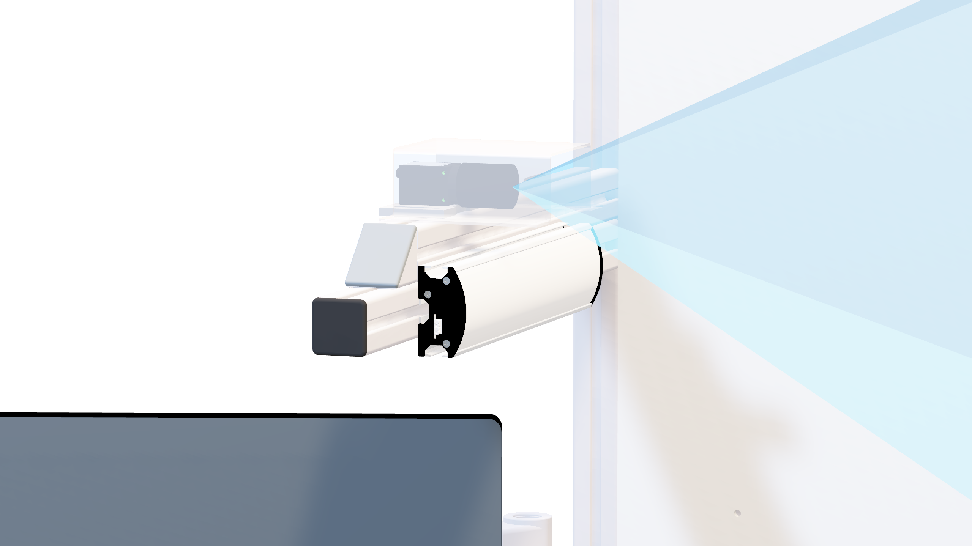
Industrial Camera
Diffuse Lighting
Source: baumer.com

Slide 5
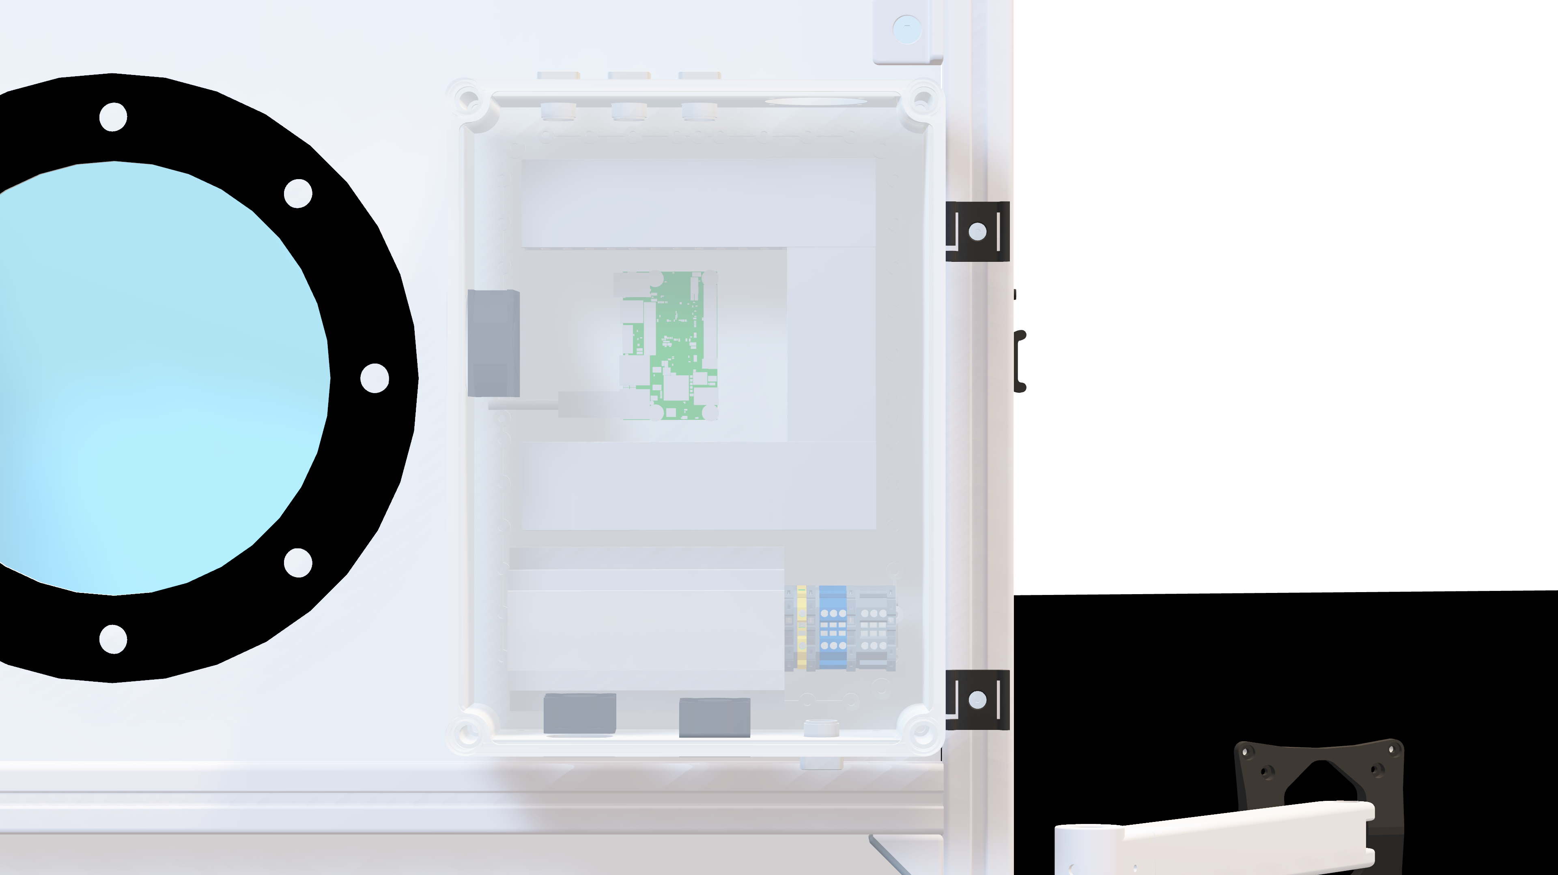
Ultra96-V2
AC/DC
Supply

Slide 6
PYNQ
Python on Zynq
Based on Ubuntu 18.04
Setup with two scripts

Slide 7
DPU
Fully configurable IP core
Setup with a script
Programmed during runtime

Slide 8
Training of the CNN
Dataset augmentation
Architecture design
Training of the model

Slide 9
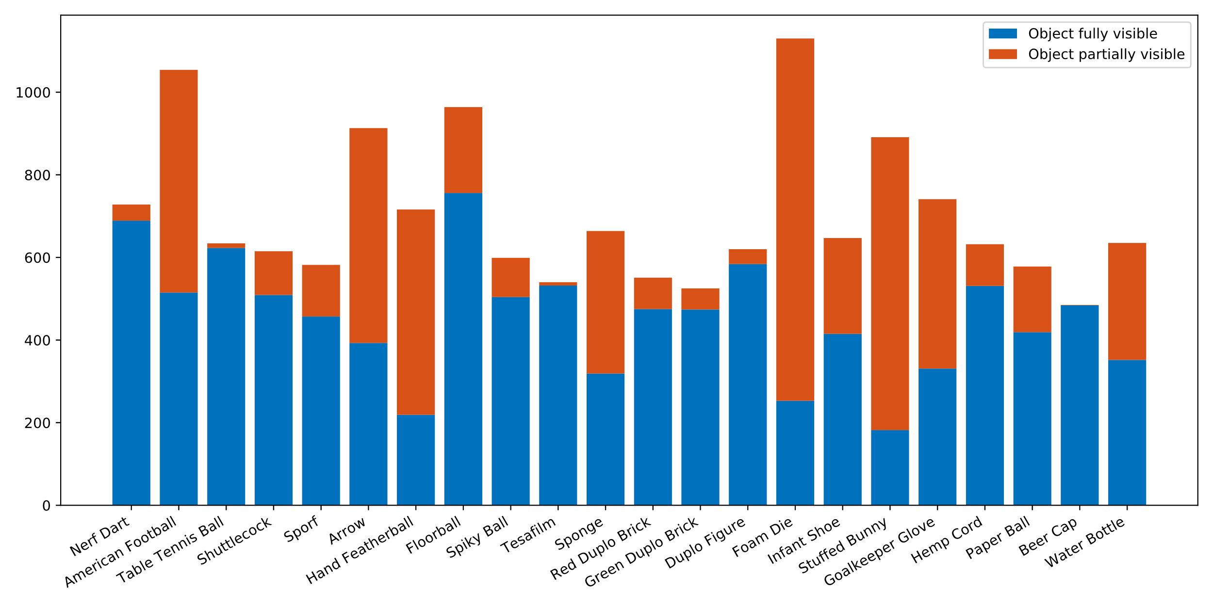

Slide 10


Slide 11
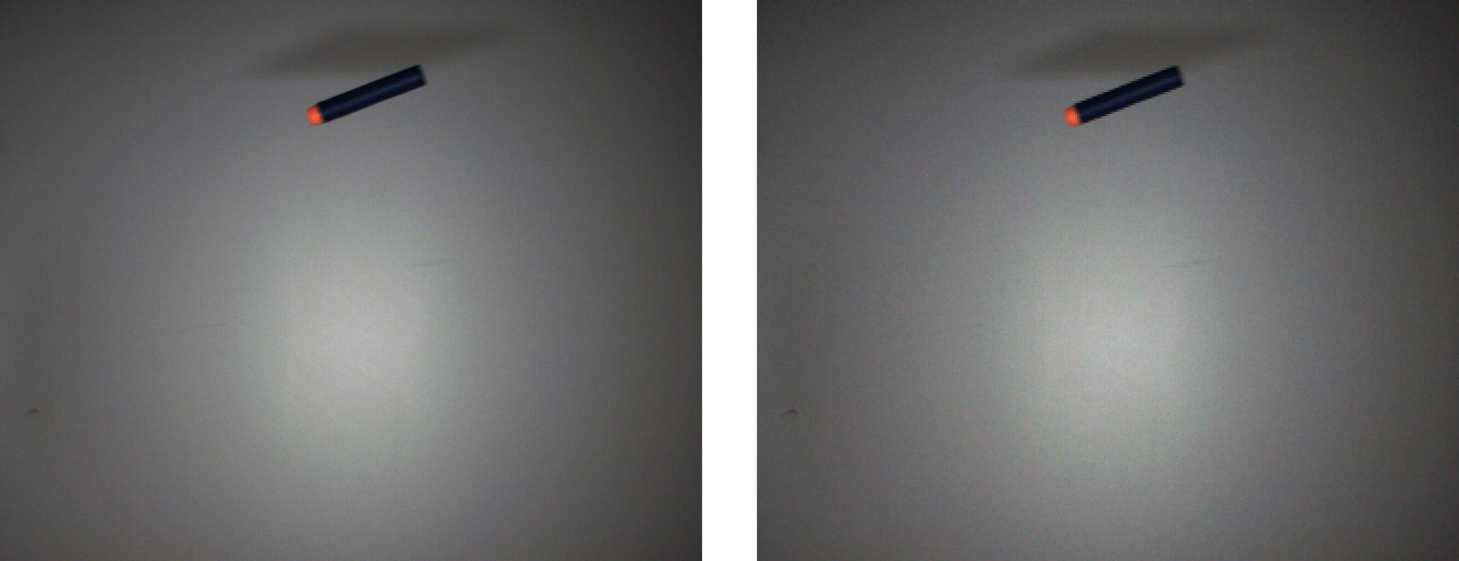

Slide 14
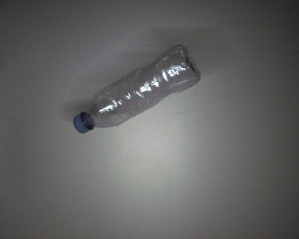

Slide 15
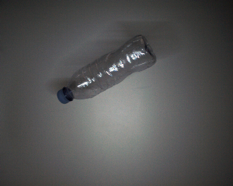
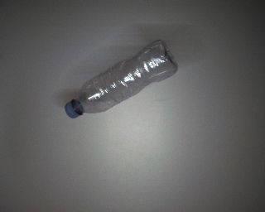
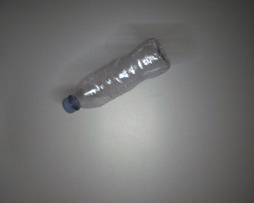
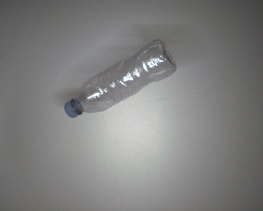
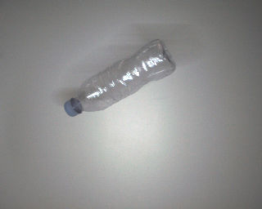
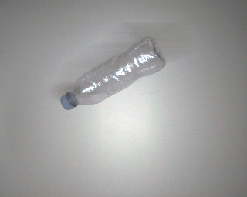

Slide 16
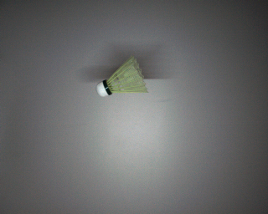

Slide 18
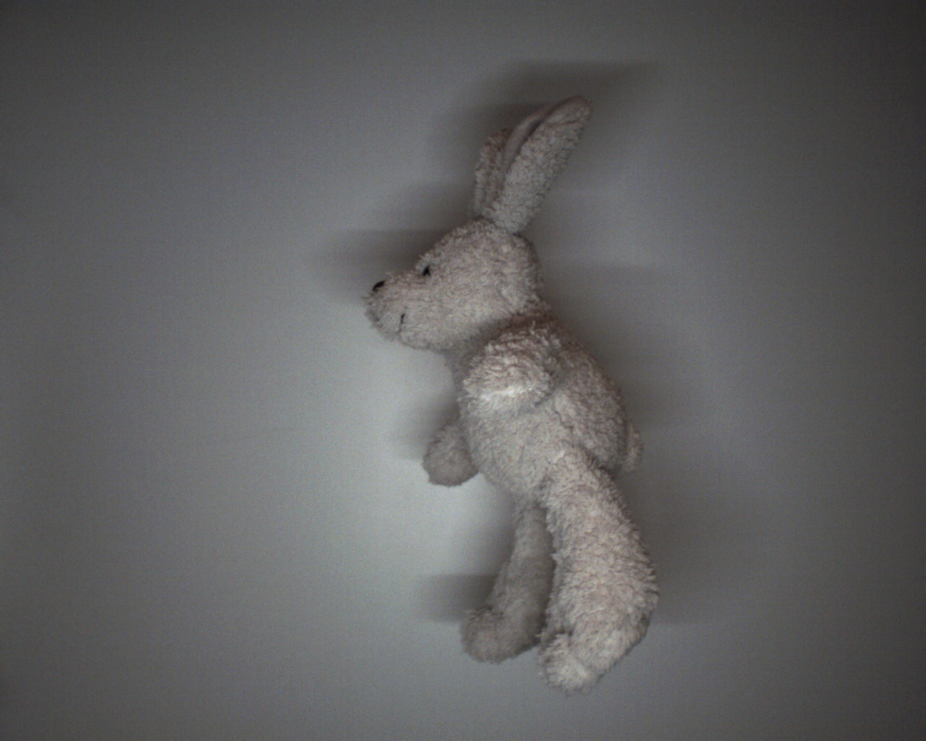

Slide 20
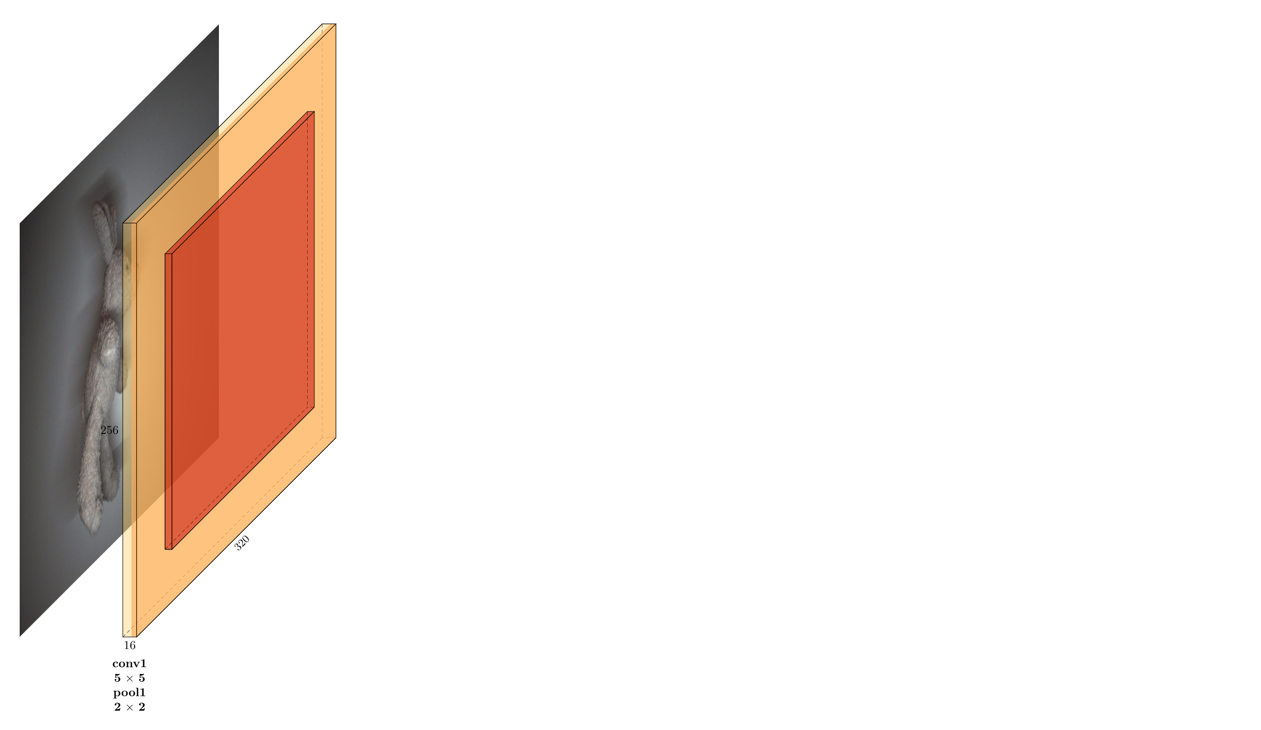

Slide 21
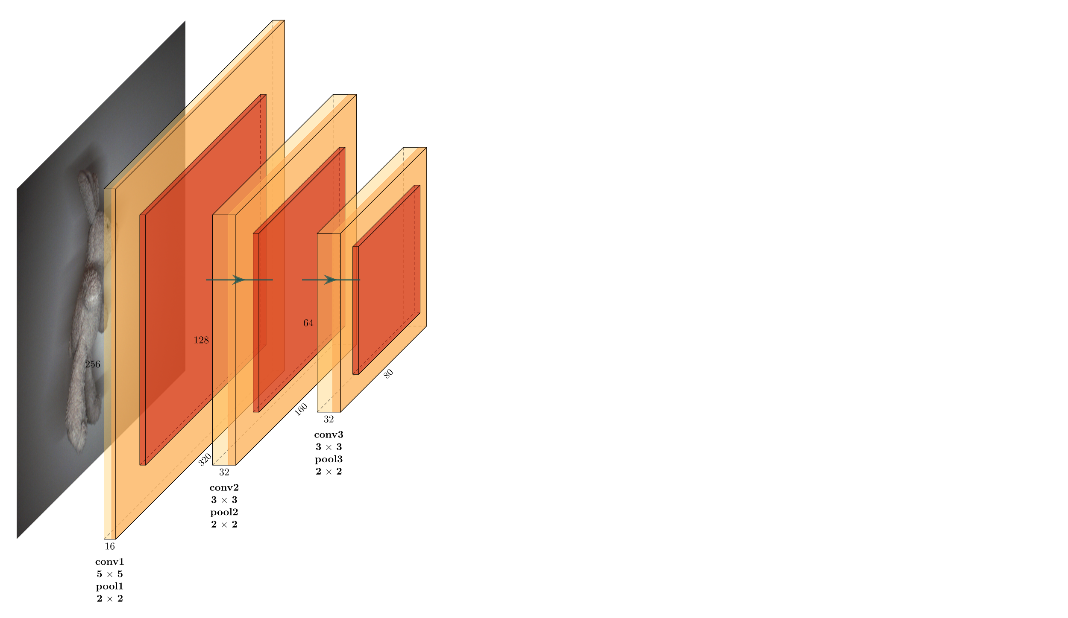

Slide 22
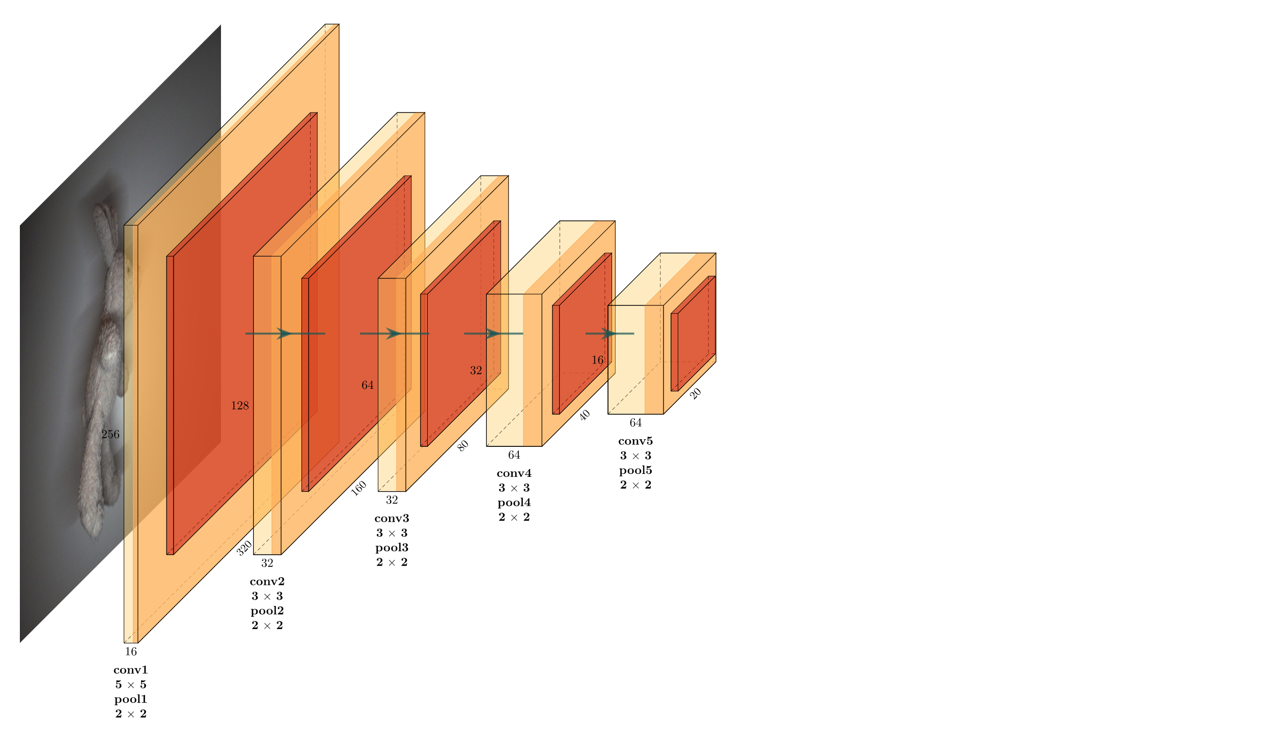

Slide 23
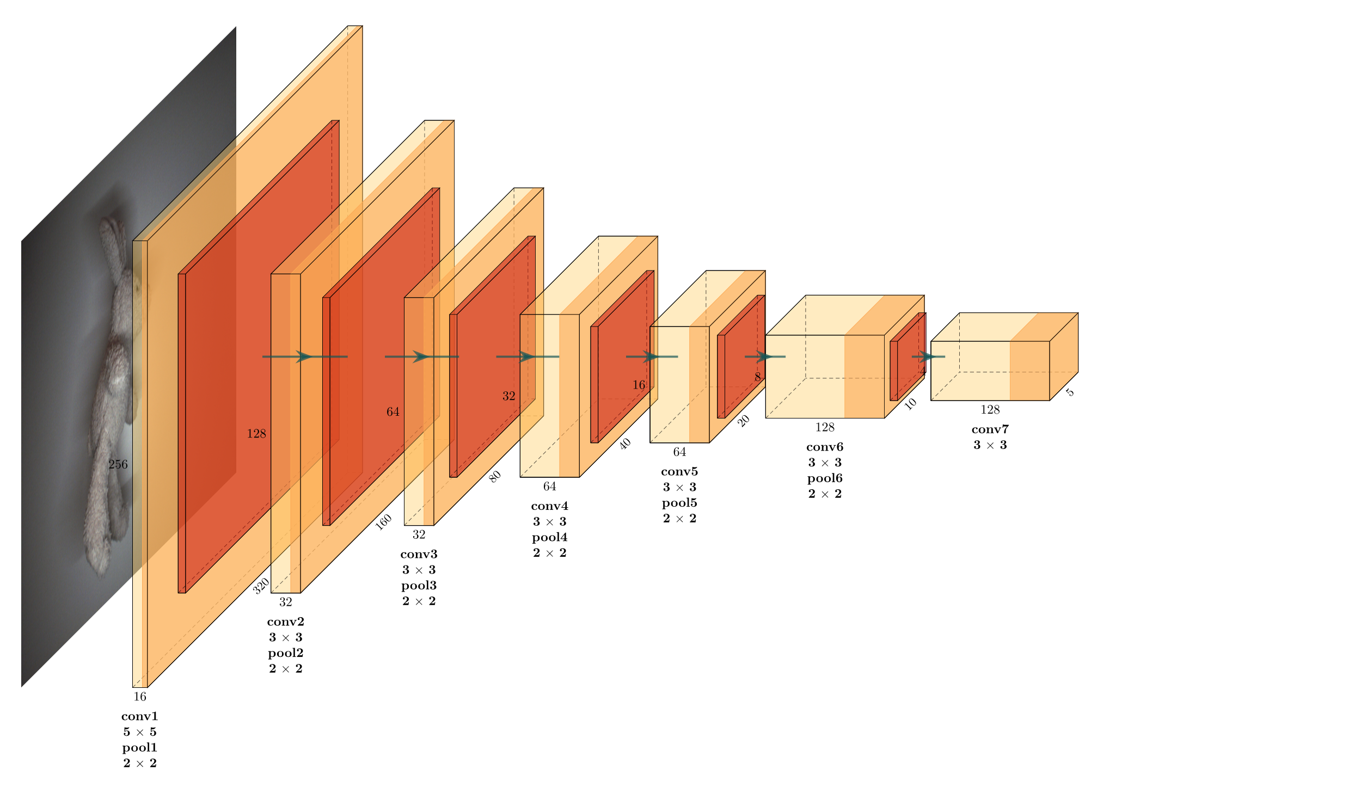

Slide 24
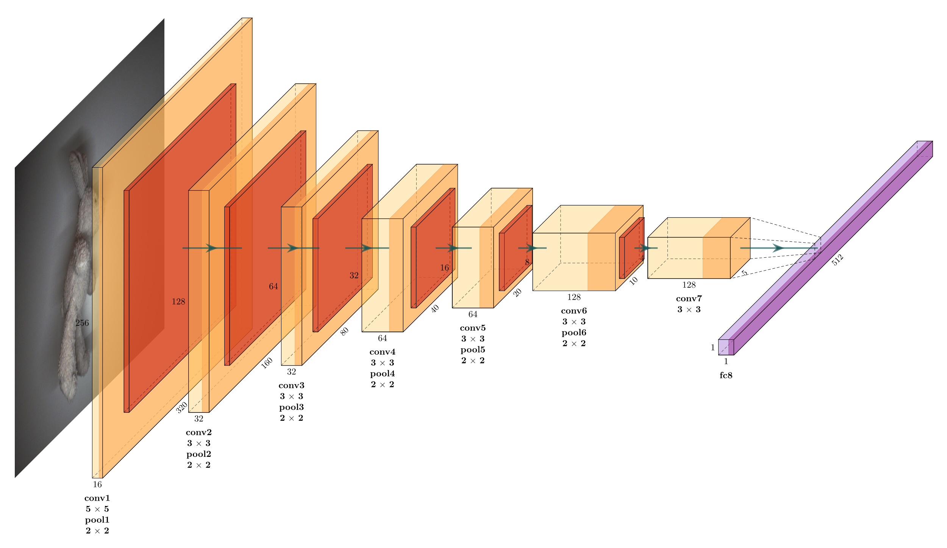

Slide 25


Slide 26
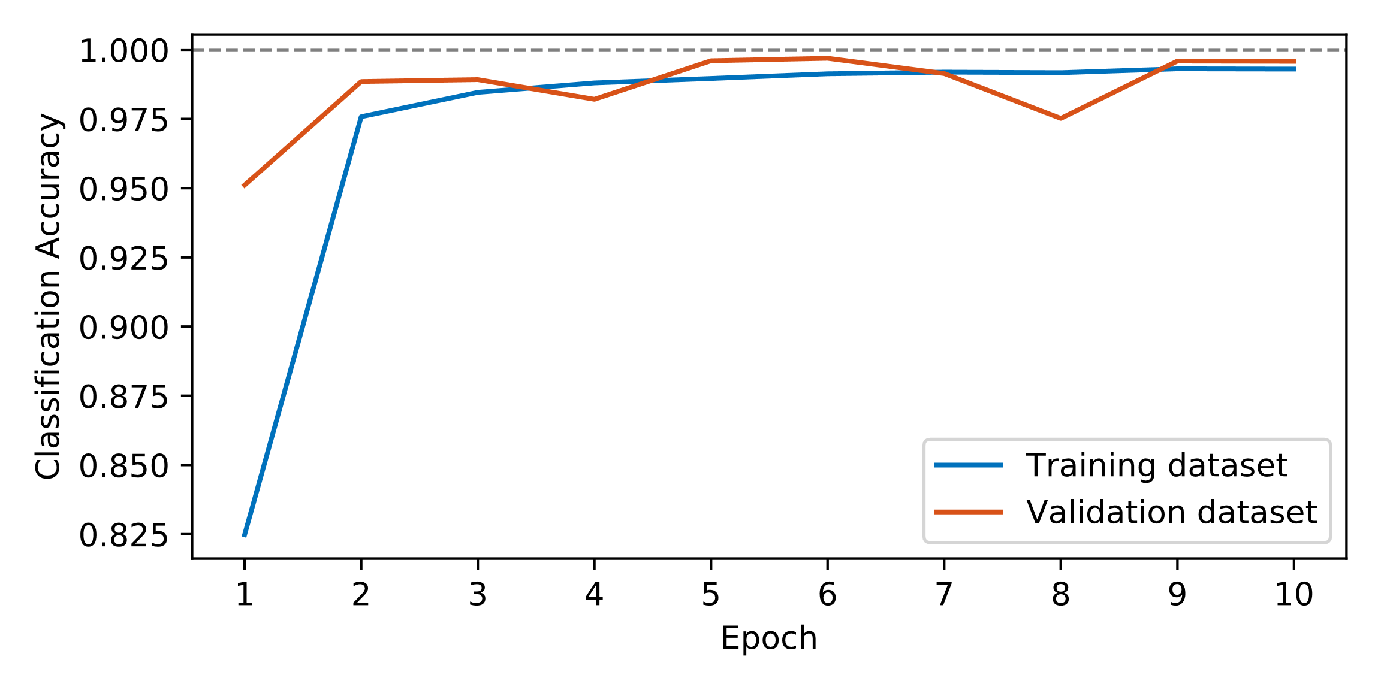

Slide 27
Model Deployment
Quantization
Compilation
Floating-point format to 8-bit signed integer format
Creates DPU instruction sequence

Slide 28
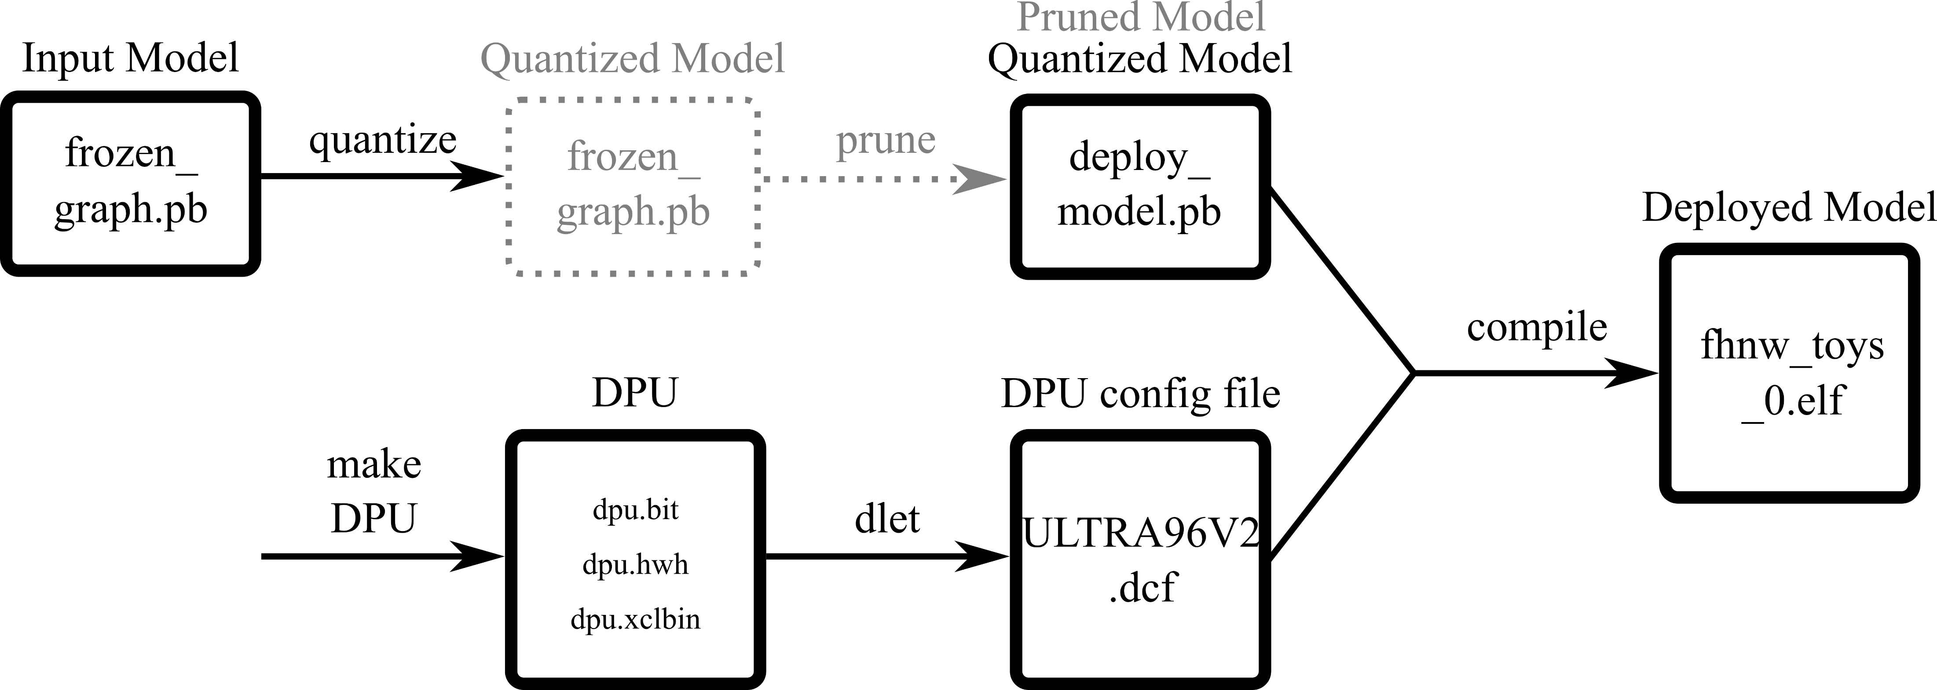
Model Deployment

Slide 29
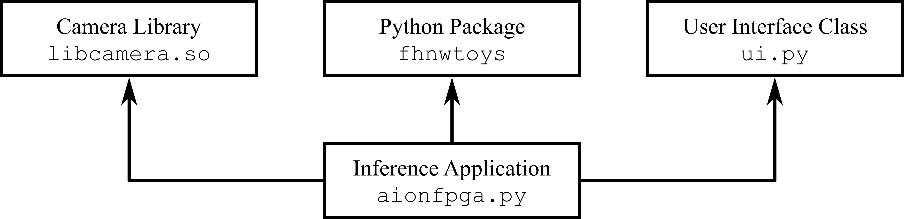
Inference Application

Slide 30
User Interface
FHNW logo
Acquired image of the thrown object
Frame from the middle of the throw
Classification statistics
Donut chart
Percentages rounded to one decimal place

Slide 31
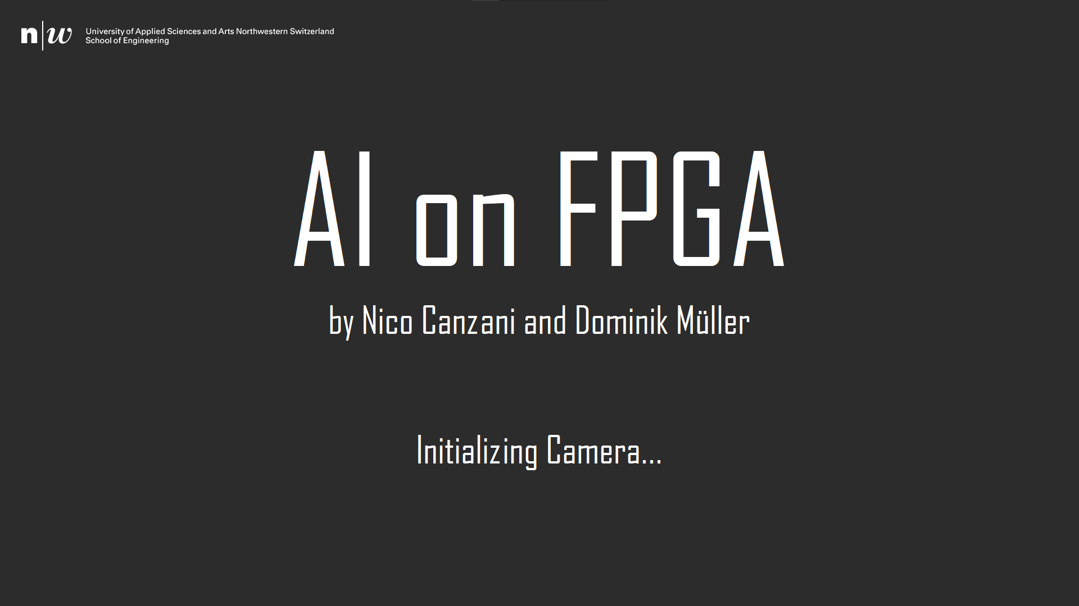

Slide 32
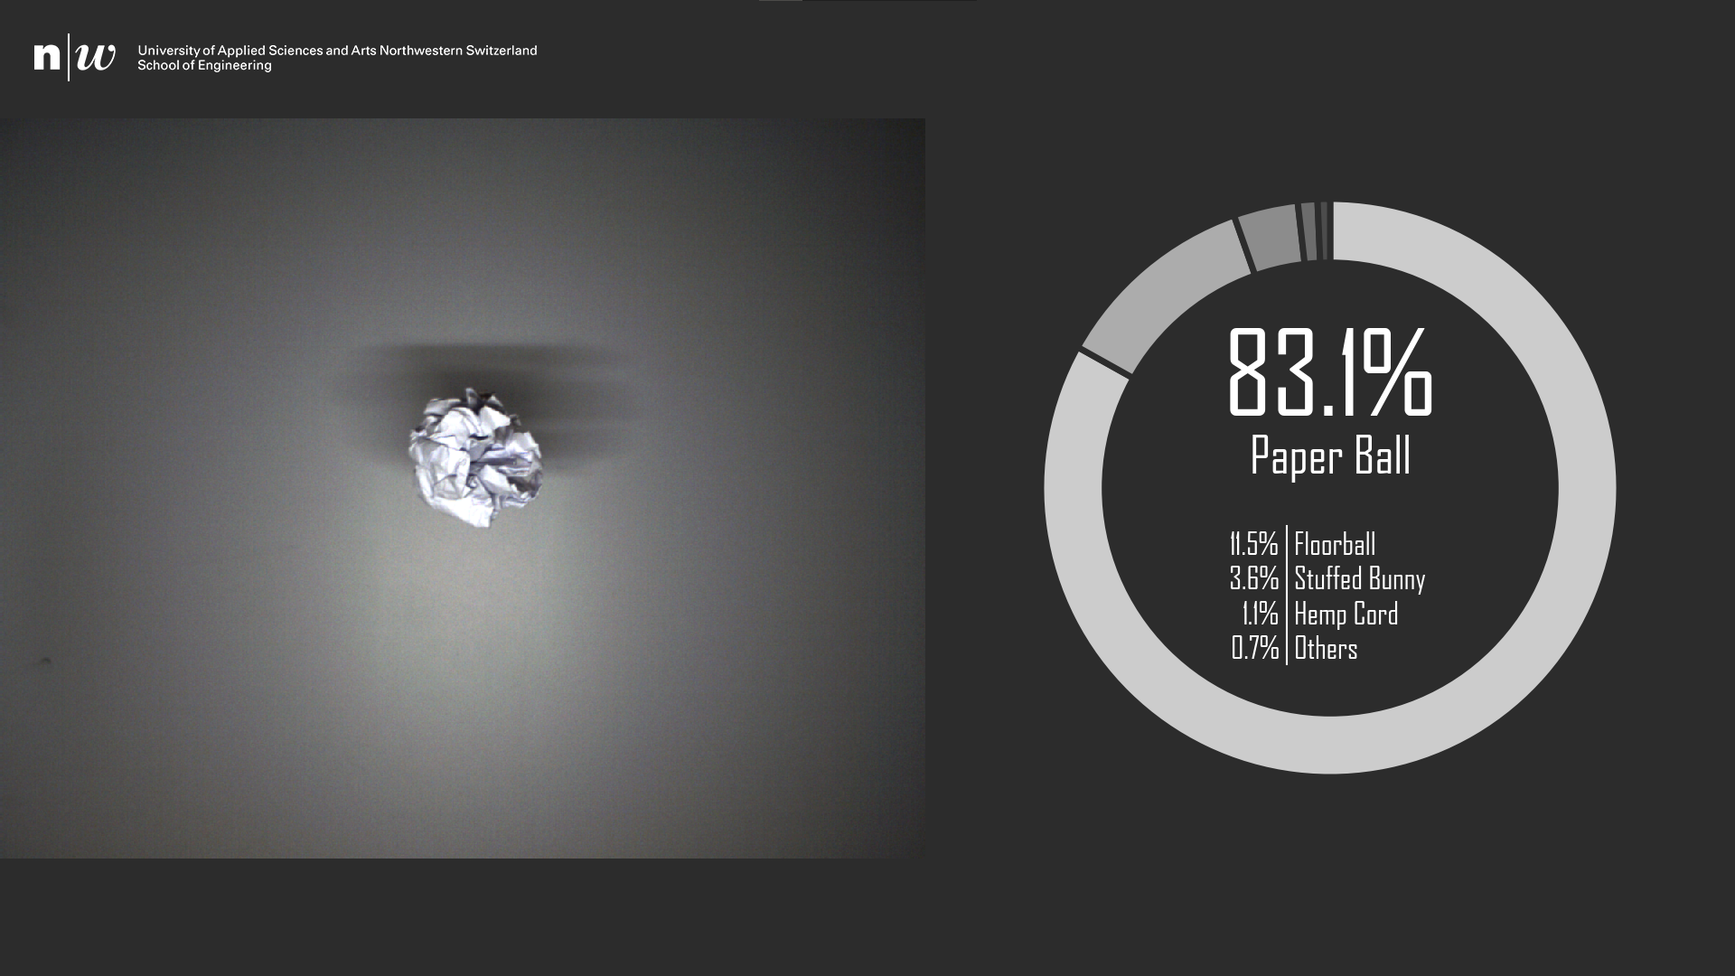

Slide 33
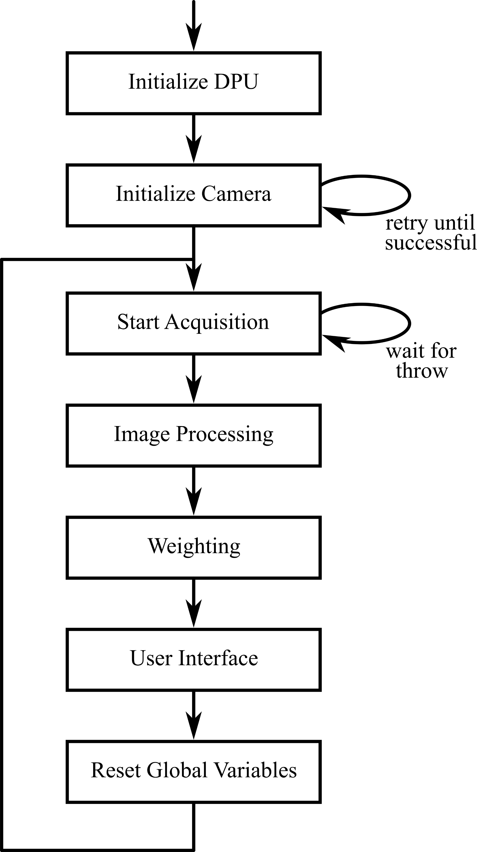

Slide 38
Image Processing

Slide 39
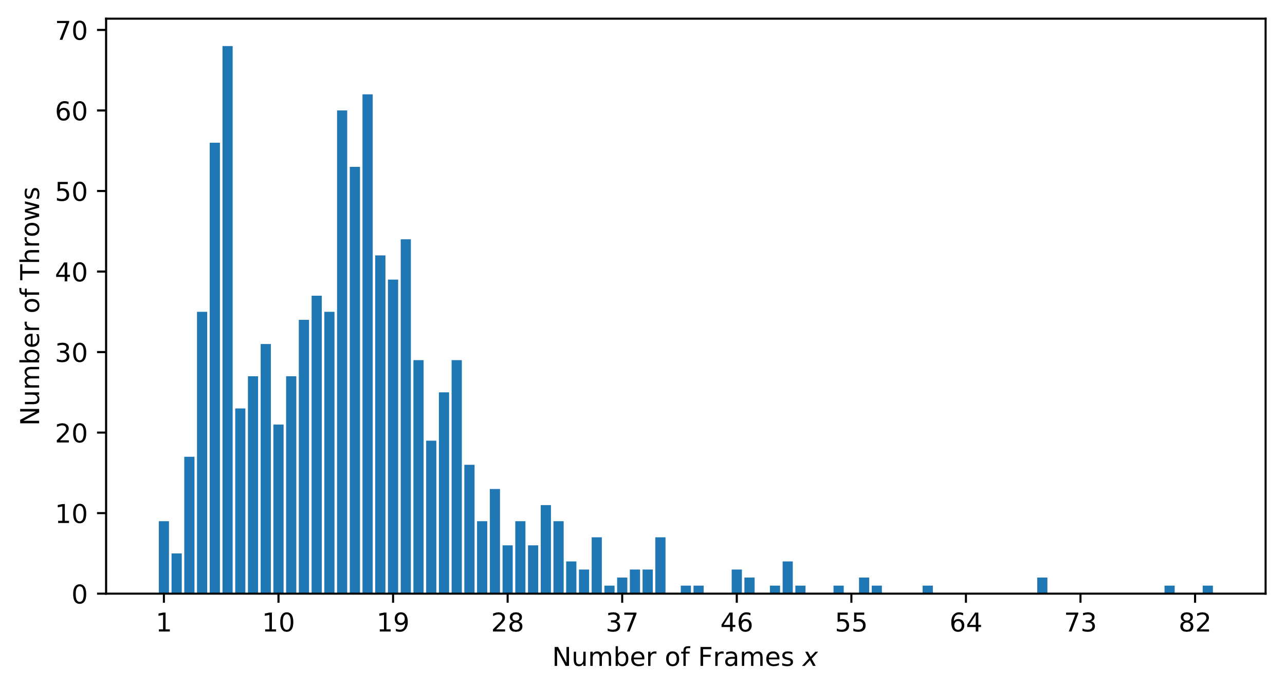

Slide 40
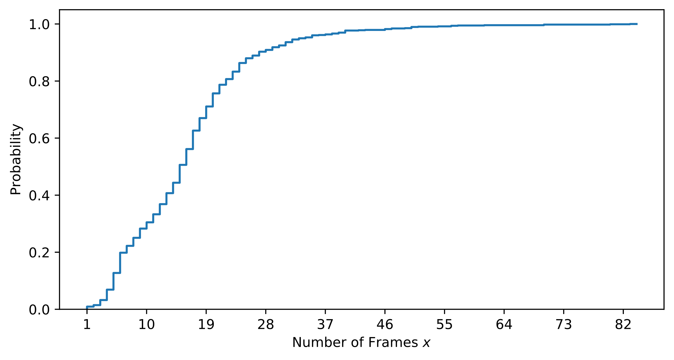

Slide 41


Slide 42
Image Processing
Getting the raw Baumer BayerRG8 frame
Converting the color space
Resizing the frame
Normalizing the pixel values
Running inference

Slide 43
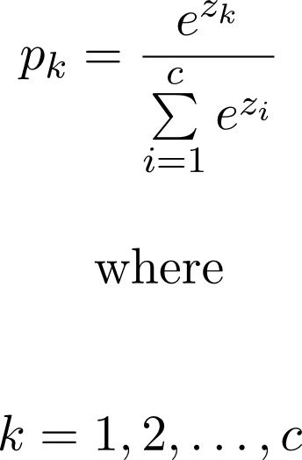
Softmax

Slide 44
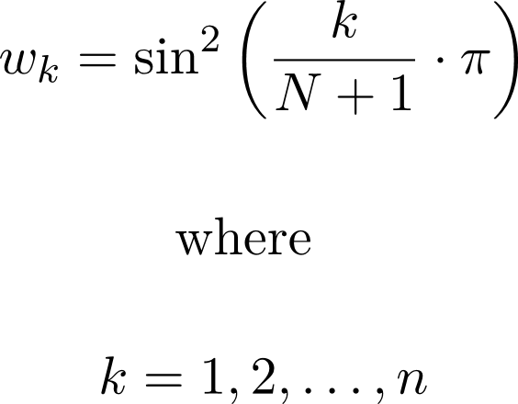
Weighting

Slide 45
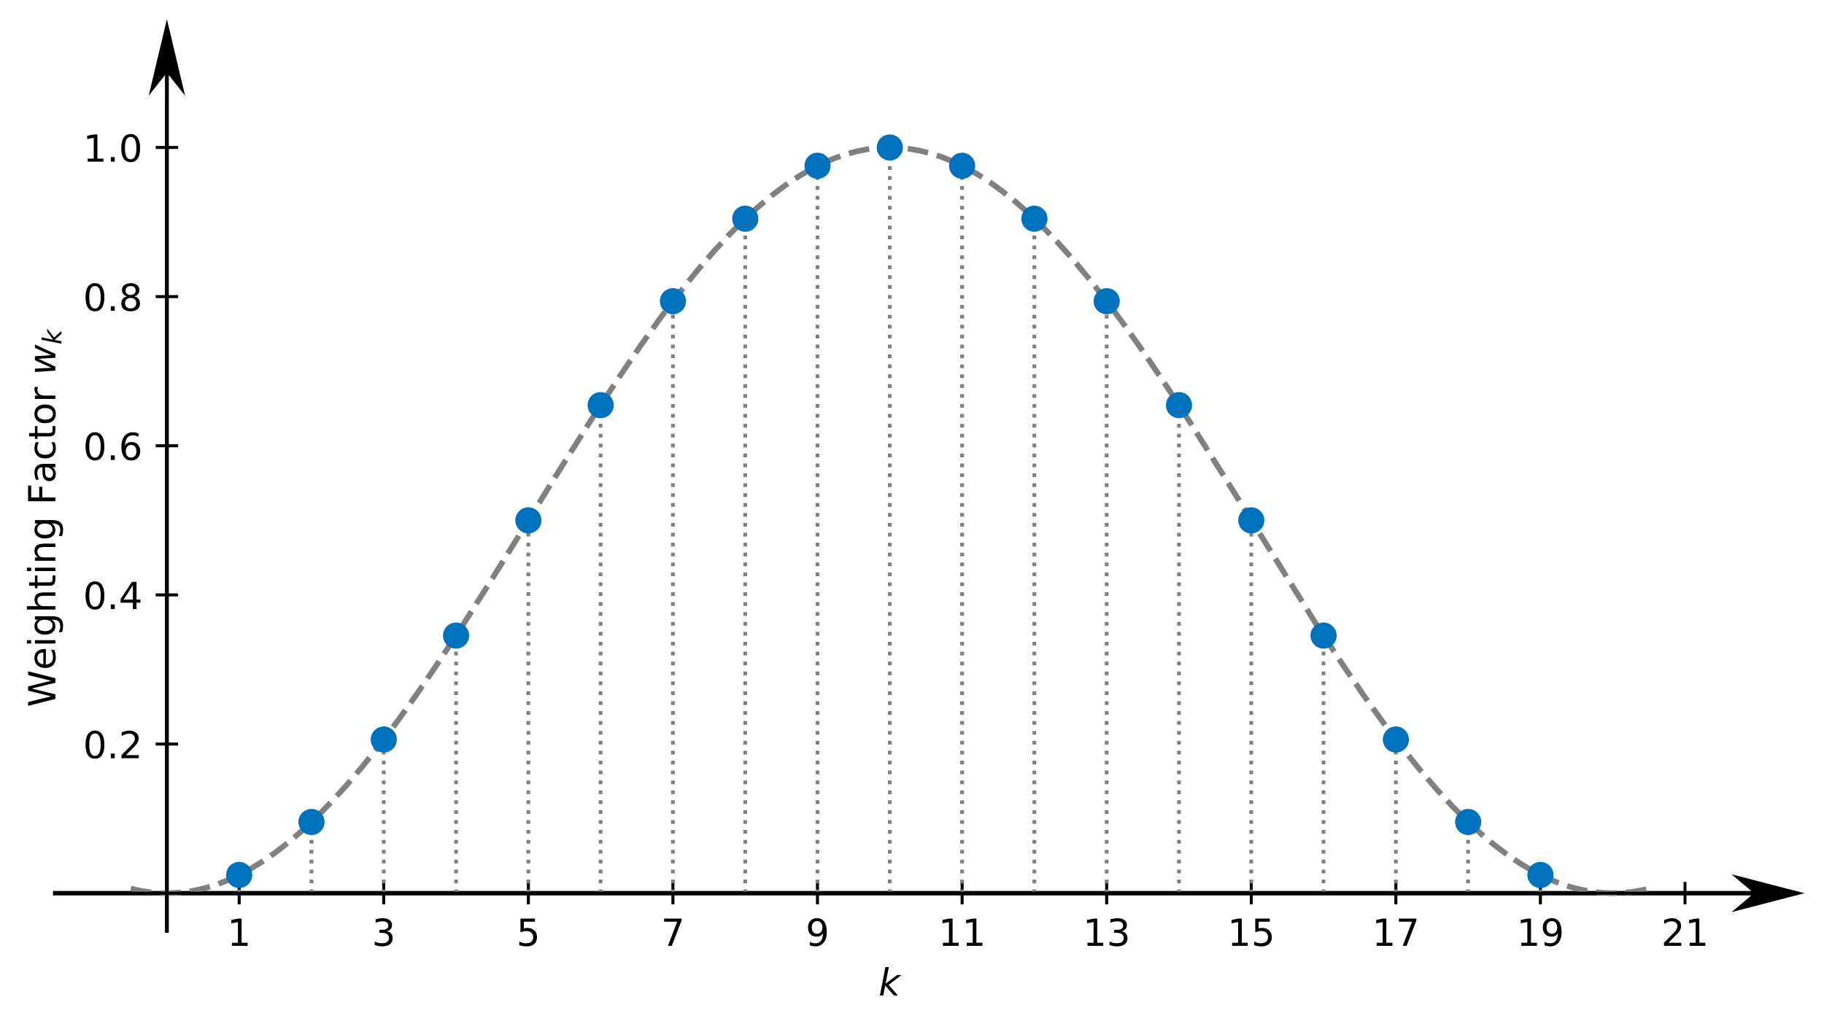

Slide 46
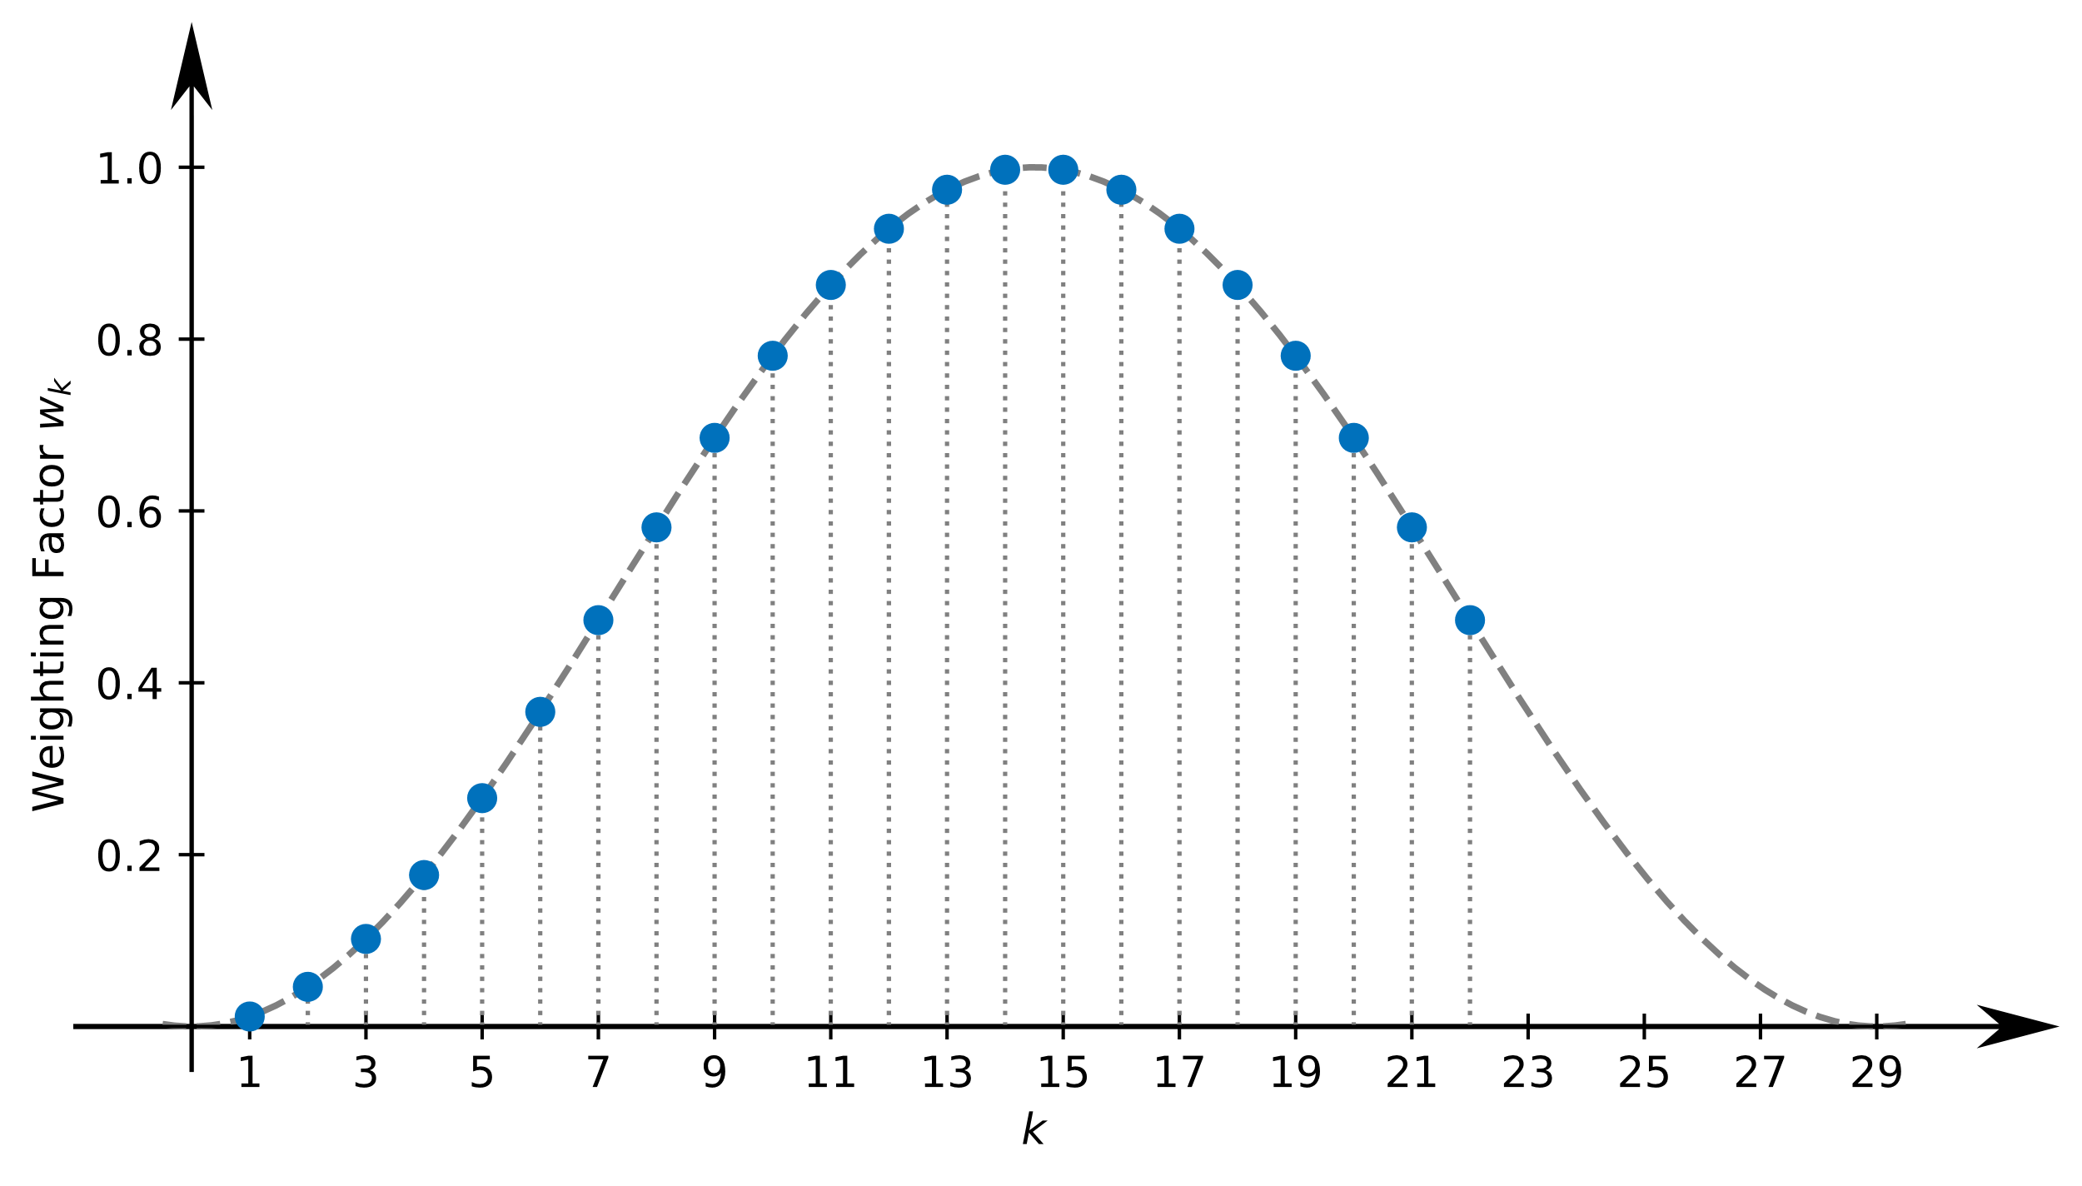

Slide 47
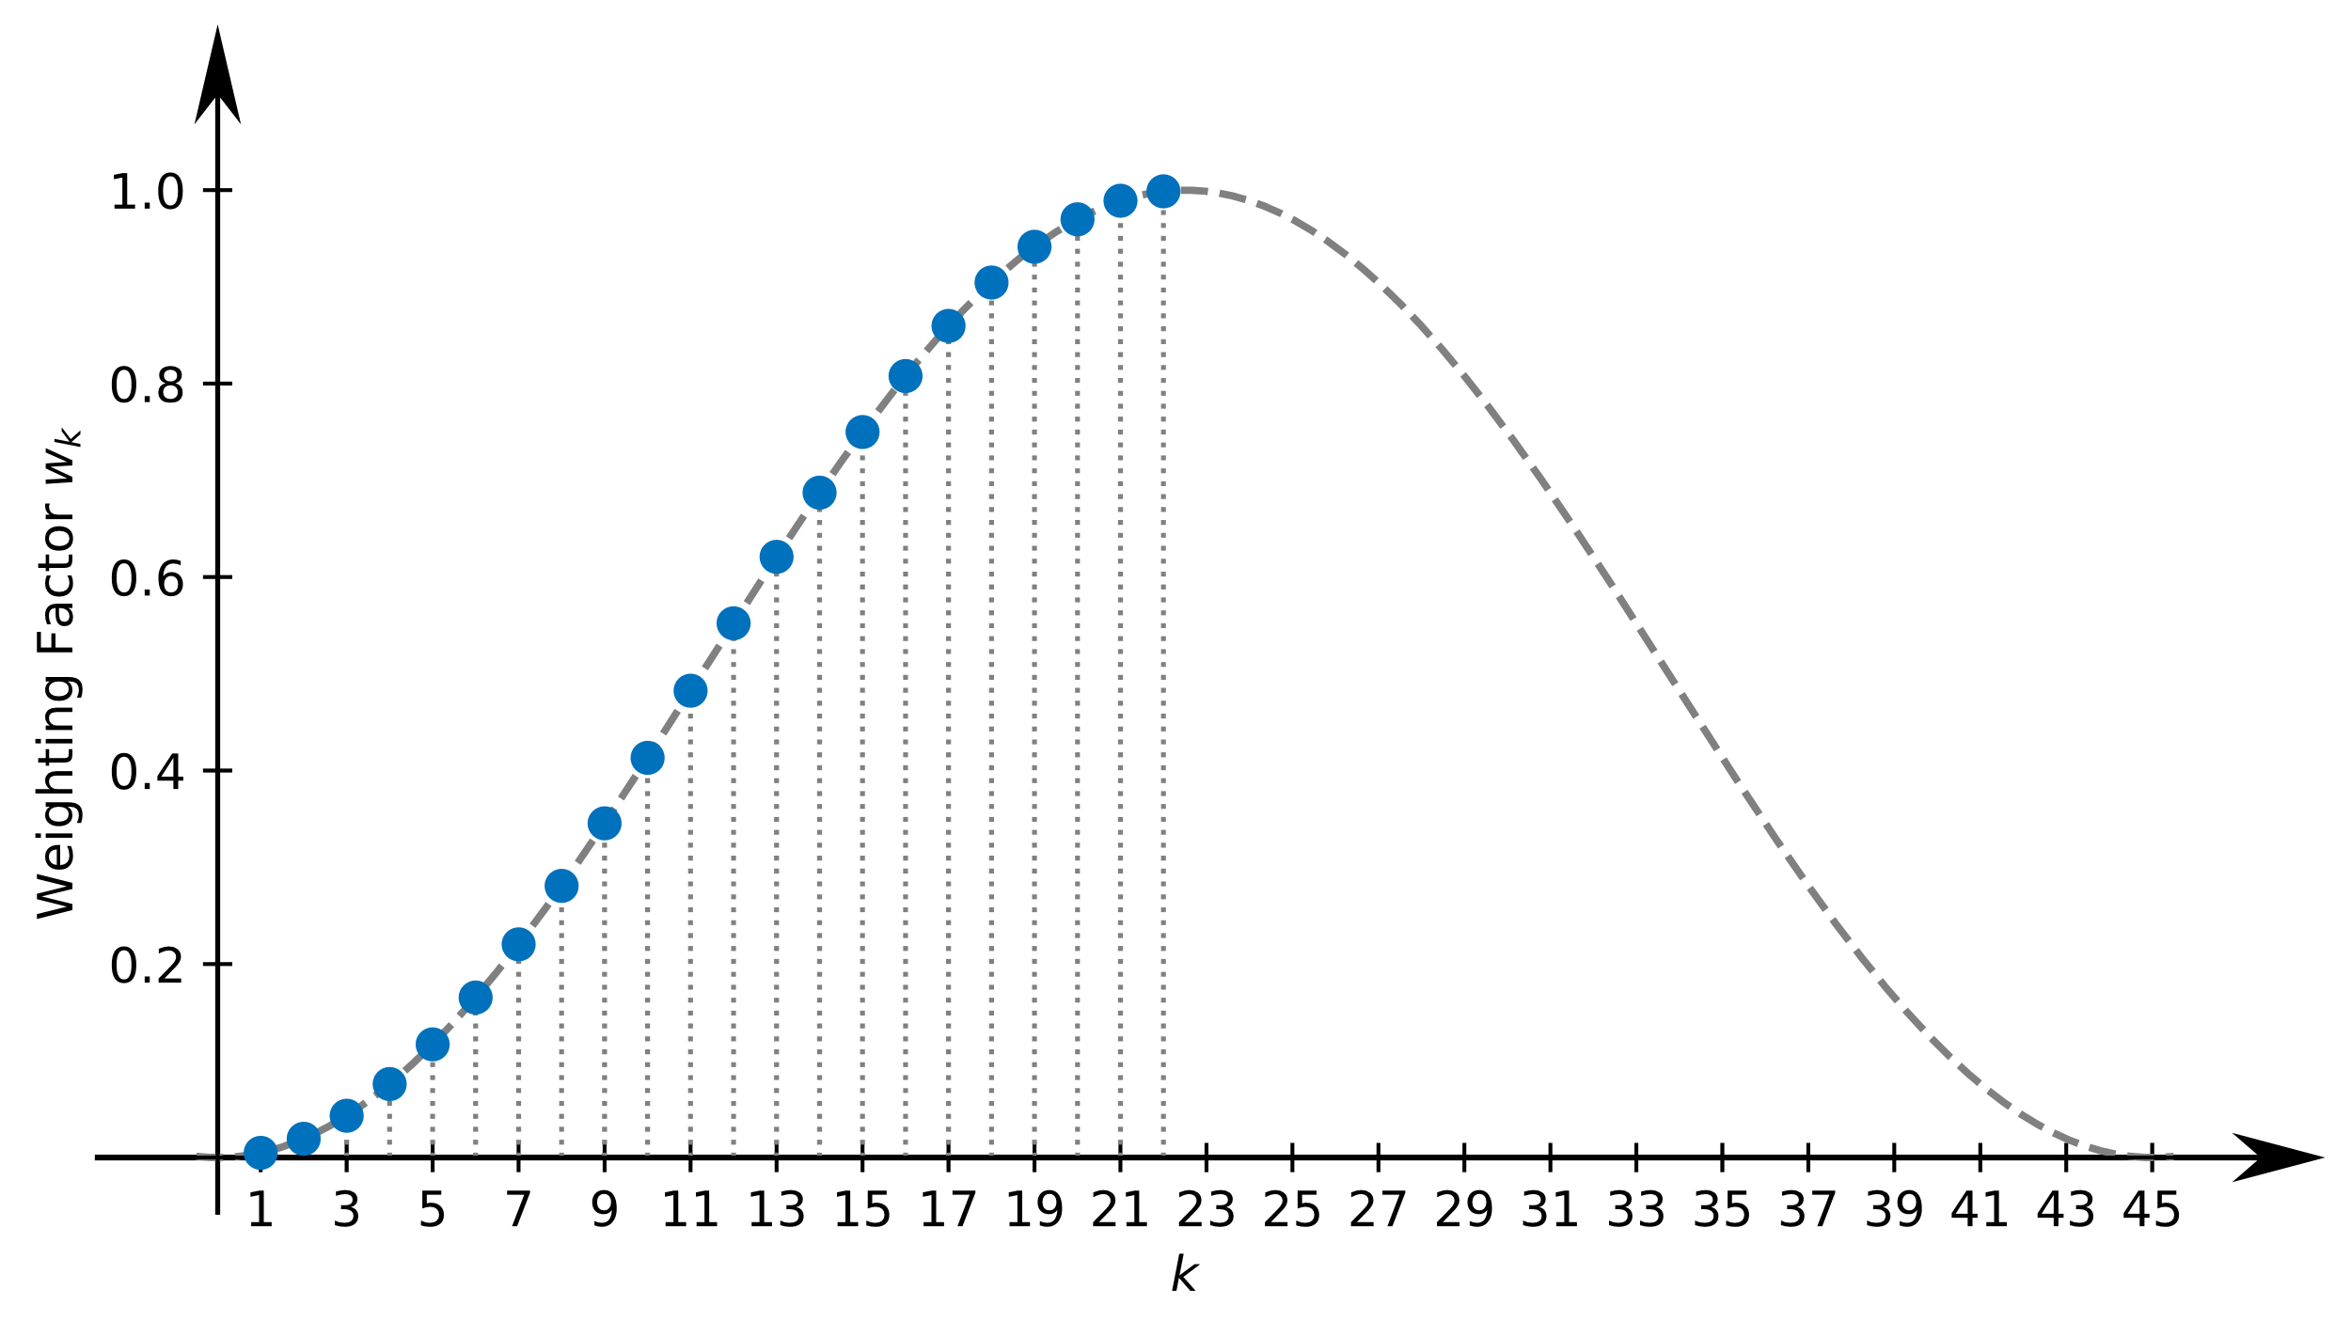

Slide 48
Verification - Classification Performance
Floating-point model
Quantized model
Top-1 accuracy: 99.5 %
Top-5 accuracy: 100 %
Top-1 accuracy: 97.2 %
Top-5 accuracy: 99.5 %

Slide 49
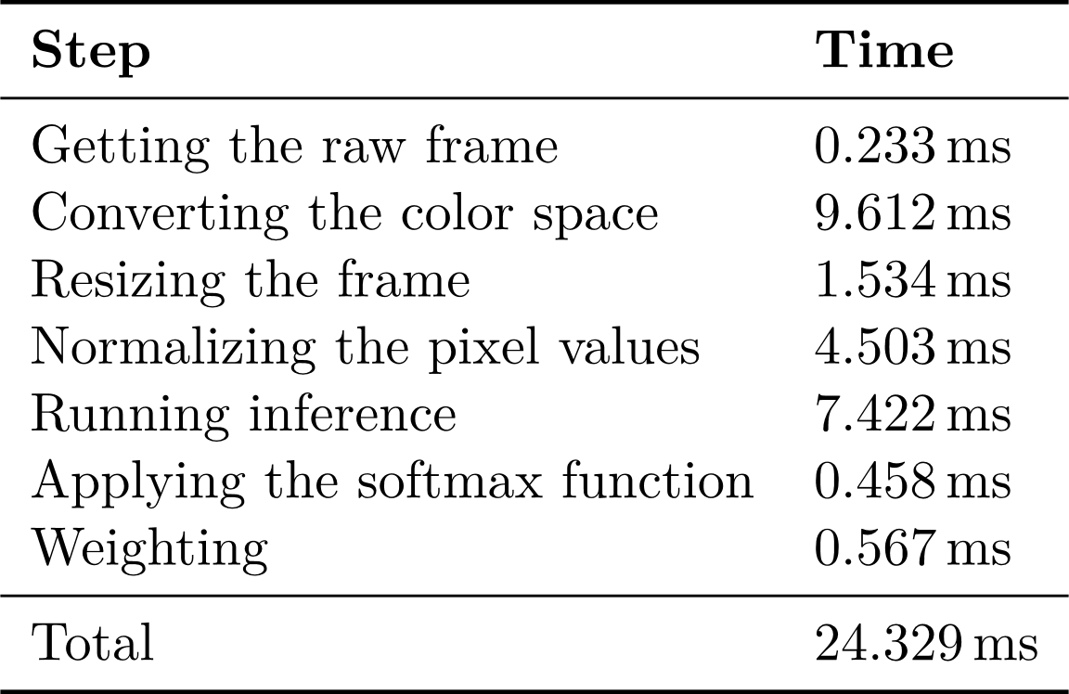
Verification - Throughput

Slide 50
Conclusion
Better development board
FPGA with more resources
Augment the dataset further
e.g. Zooming

Slide 51
Experiences
Positive
Negative
TensorFlow 2
Xilinx
Baumer
Avnet

Slide 52
Questions

